Slide 1
YOFE
East Harlem Youth Food Educators

Slide 2
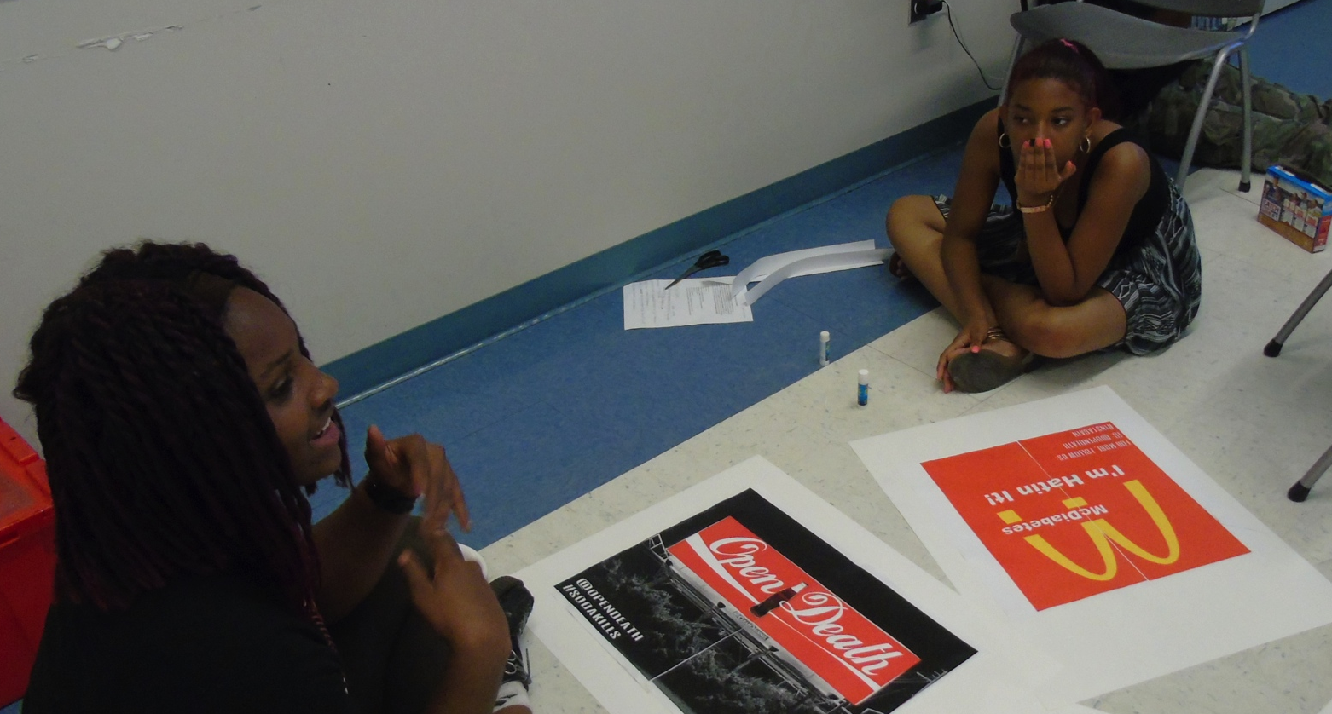
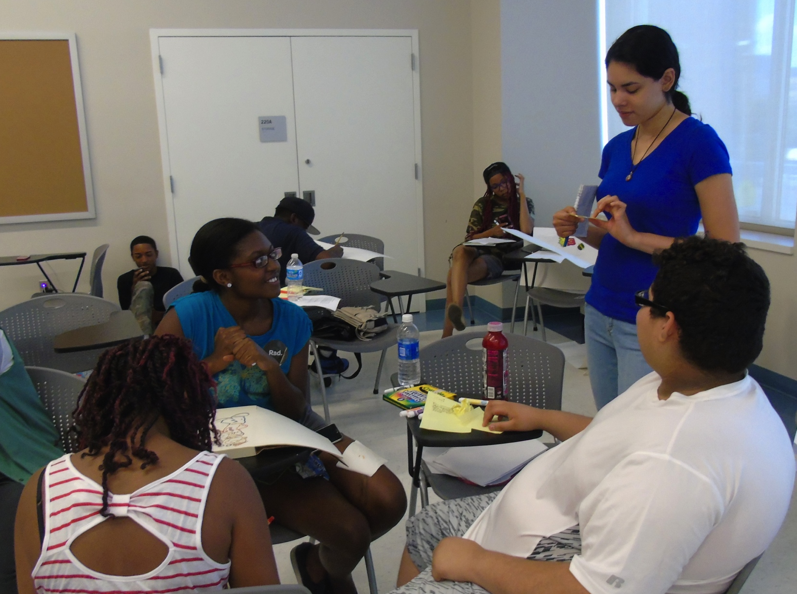
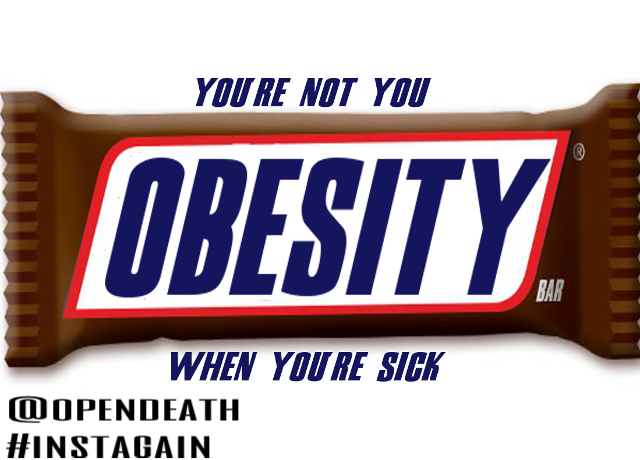
YOFE Program
Counter-Marketing

Slide 3
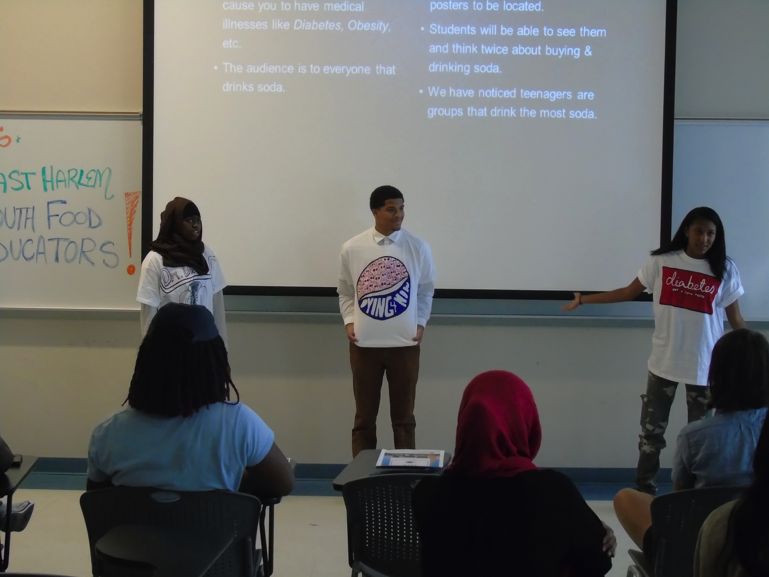
Campaign Ideas
“A Toast to Death”

Slide 4
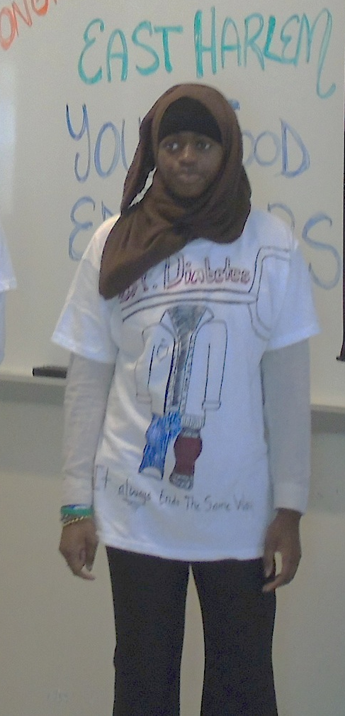
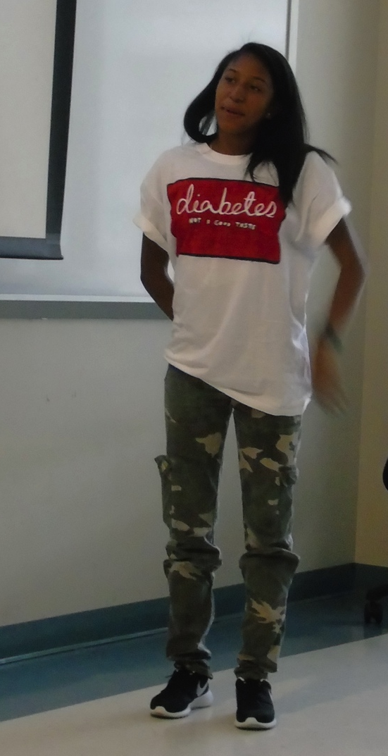
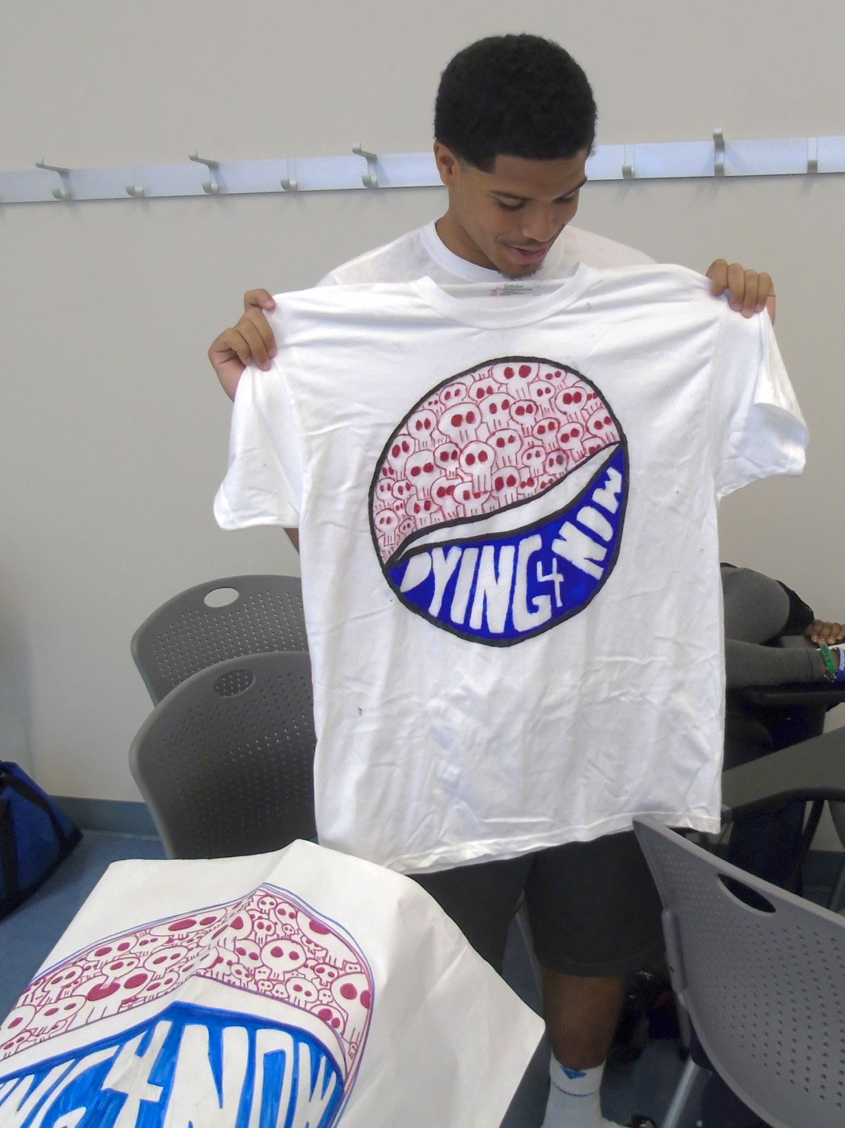
“A Toast to Death”
Pepsi
“Dying 4 Now”
Dr. Diabetes
“It always ends the same way”
Coke/Diabetes

