Slide 1
Labor Market Trends in New York City’s Food Industries
Good Food Jobs Forum
New York City Food Policy Center
CUNY School of Public Health
October 17, 2013

Slide 2
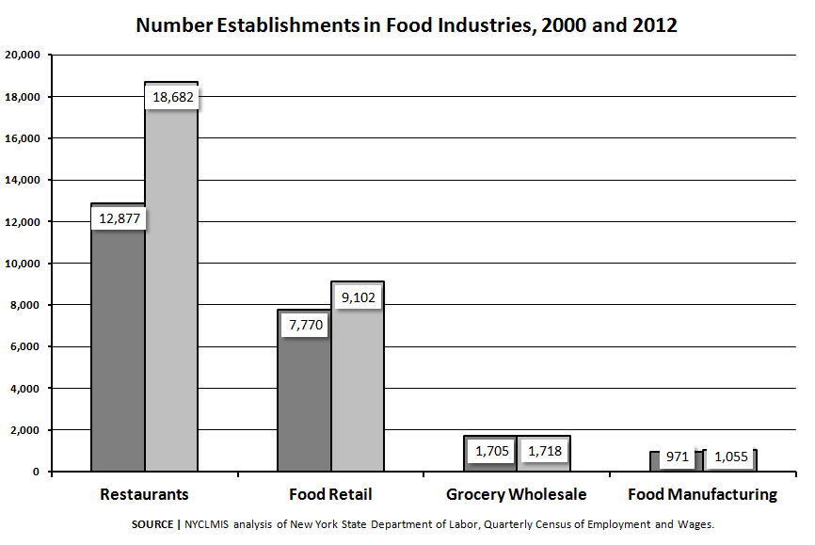

Slide 3
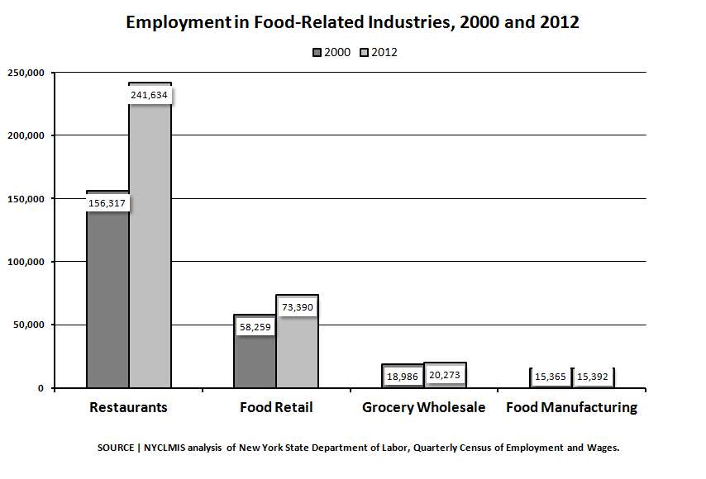

Slide 4
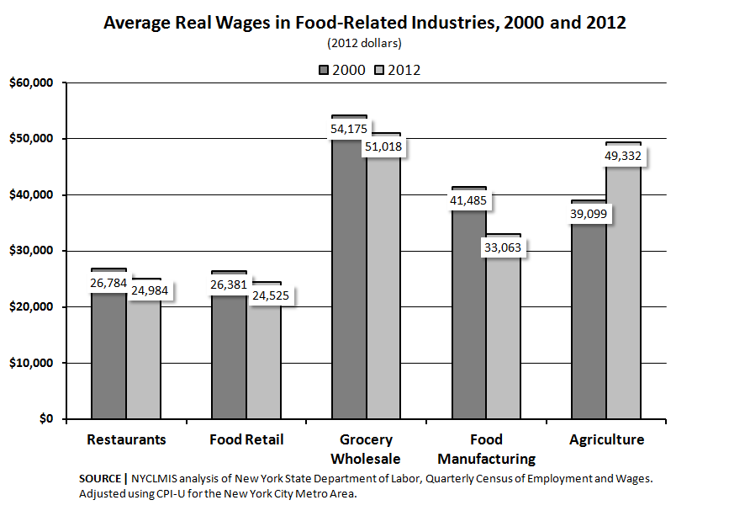

Slide 5
Demand by Occupation (past 90 days)
Occupation | Volume
Food Supervisors | 3,772
Waiters/Waitresses | 2,679
Cooks, Restaurant | 1,897
Chefs and Head Cooks | 1,179
Combined Food Preparation and Serving Workers | 1,141
Food Managers | 917
Bakers | 53
Butchers | 35
Food Batchmakers | 17
Meat and Fish Cutters and Trimmers | 11
Food Roasters | 3

Slide 6
Skills, Tools and Certifications in Demand (past 90 days)
Skills & Tools | Certifications
Credit Card Machuines | Food Safety HACCP
Preventive Maintenance Inspection | ServSafe
Quality Control | OSHA
Bilingual | Certified Executive Chef
Cutting Equipment | Certified Dietary Manager
Broilers | Registered Dietitian
Steam Tables | National Environmental Health Association

Slide 7
Thank you!
Lesley Hirsch
NYC Labor Market Information Service
CUNY Graduate Center
365 Fifth Avenue, Room 6202
New York, NY 10016
212.817.2031
lhirsch@gc.cuny.edu
www.gc.cuny.edu/lmis

