Slide 1
Isobel Contento, PhD
Pamela Koch, EdD, RD
based on the doctoral dissertation of Kathleen Porter, PhD, RD
2013

Slide 11
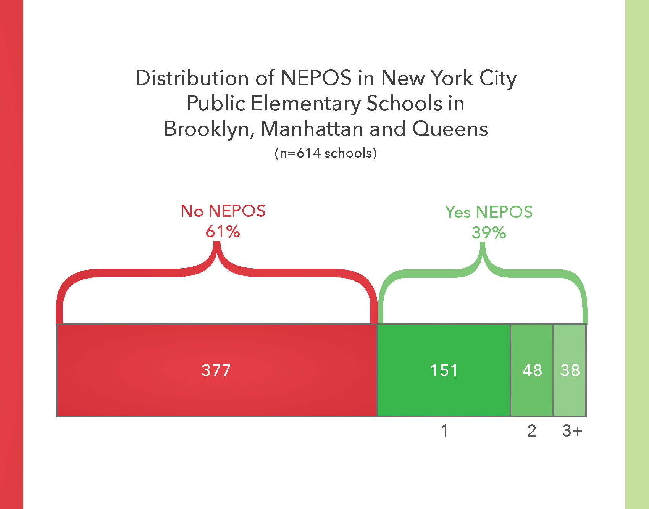

Slide 20
Watch for our upcoming report!

